Slide 1
Mn ore and alloys market review and perspective The 3rd Asian Pacific Ferro-Alloys & Steel International Conference Bangkok mar 1st 2017

Slide 2
Outline
1 – Mn market review
A – Supply,
B – Demand,
C – Supply/Demand Balance
D – Impact on China market
2 – Mn market perspective

Slide 3
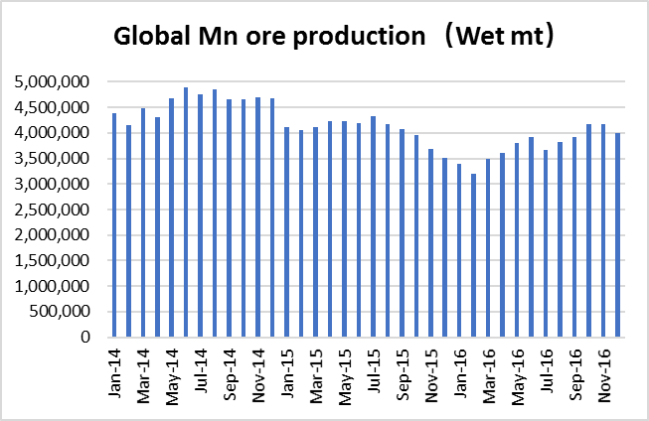
1 – Mn market review
A – Mn ore supply
In 2016, global Mn ore production was 45.2 million wet metric tons, down by 7.3% from 2015; high grade ore (Mn>44%) production was 14.36 million tons, down by 16% from 2015.
Due to weak market, some main Mn ore mines announced to cut or stop production during end of 2015 and beginning of 2016:
Woodie Wooodie (CML) in Australia;
Bootu Creek (OMH) in Australia;
UMK and Tshipi in RSA;
Eramet Comilog in Gabon
Swing suppliers already stopped production earlier than the main suppliers
Along with Mn ore price increase from July, most the above mines started to come back from Q4 2016.
In General, global Mn ore production was in low level, high grade ore production was even less.

Slide 4
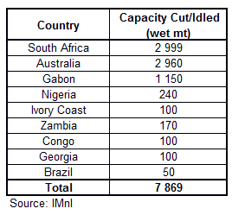
1 – Mn market review
A – Mn ore supply
Production cuts in announced in 2015/2016:
Globally, around 8 million mt of Mn ore capacity cuts have been announced at the end of 2015 and beginning of 2016, due to low Mn ore prices and high stock levels.

Slide 5
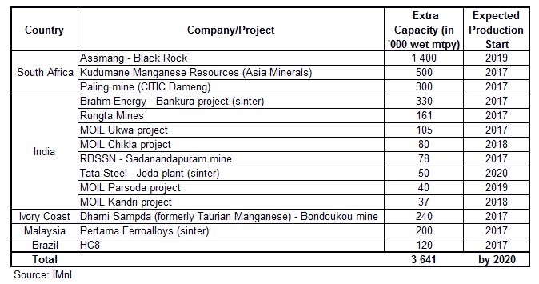
1 – Mn market review
A – Mn ore supply
Several new manganese ore projects have been announced to come on stream over the next few years, especially in Africa and Asia.
Around 3 million mt of extra capacity is expected to come on line by 2020, plus 580,000 mtpy of sinter.
Extra capacity is much lower than mine closure (-8 Mt per year in 2015-2016), but some production cuts are temporary, and idled mines could restart if prices increase.

Slide 6
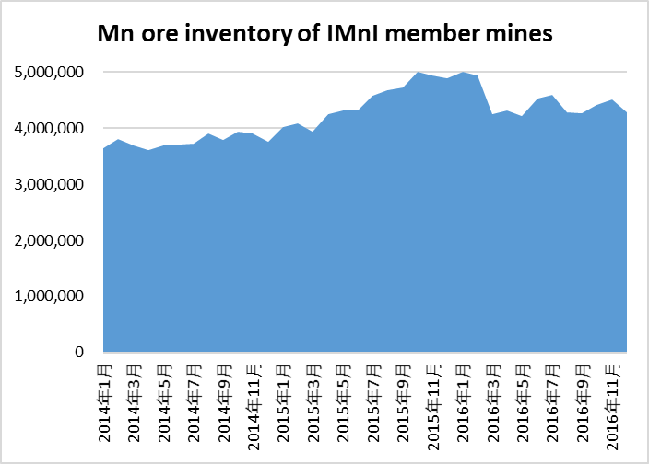
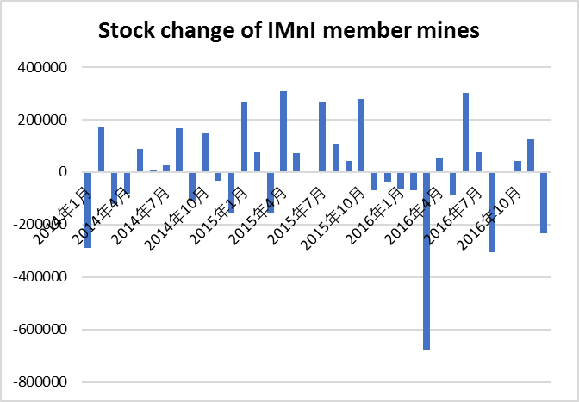
1 – Mn market review
A – Mn ore supply
From 2014 to Feb 2016, Mn ore inventory at mines (only IMnI members) kept increasing, it reached highest level of 5 million tons in late 2015 and early 2016. After then, Mn ore inventory started to reduce, we can see very important destocking in Mar, Aug and Dec. Mn ore inventory at mining companies (IMnI members) was 4.27 millions by end of 2016, which is at reasonable level now.

Slide 7
1 – Mn market review
B – Mn ore demand
In 2016, world crude steel production was 1.713 billion tons, similar level as 2015.
- In Dec, world crude steel production was 144 million tons, higher by 5.2% y-o-y.
- Stable growth of crude steel production supported demand and consumption of Mn alloys.

Slide 8
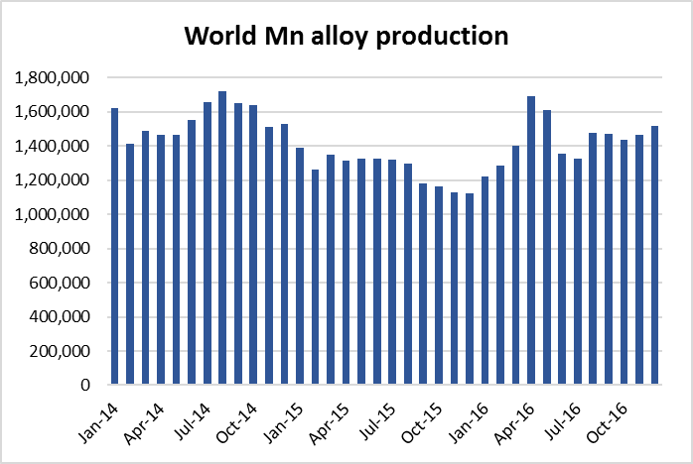
1 – Mn market review
B – Mn ore demand
In 2016, global Mn alloy production was over 17.3 million tons, higher by 13% from 2015, it largest stimulate the demand of Mn ore.
By products
SiMn production increased by nearly 20%, HCFEMN production dropped by 5% and Refined FeMn production dropped by 15%.
By regions
Production in Asia significantly increased by over 17%, mostly from China, Malaysia and India.
Production in CIS and America also increased.
Production in Africa and middle east reduced by 20%.
The recovery of Mn alloy market especially SiMn market in 2016 stimulate the global Mn alloy production, this pushed up the Mn ore demand.

Slide 9
1 – Mn market review
C – Mn ore S/D balance
On one side, global Mn ore production decreased in 2016, on the other side, Mn ore demand increased driven by booming Mn alloy market, these totally changed the Mn ore supply/demand balance.
→ After several years of Mn ore destocking, oversupply situation was well eased. High grade Mn ore even faced shortage in certain period.
Discipline from supply side and recovery from demand side helped Mn ore industry experience a crazy year in 2016.

Slide 10
1 – Mn market review
C – Mn ore S/D balance
Price movement is the direct result of supply/demand balance
Mn ore price comes back to rational level after crazy increase in 2016. The main reasons of soaring Mn ore price in 2016 are temporary shortage of high grade ore and booming Mn alloy market. Reasons for current price drop are:
Weak Mn alloy market in China;
Some trading companies cleaning up Mn ore inventory;
Psychological worry about future market.

Slide 11
1 – Mn market review
D – Impact on China
China Mn industry relies more and more on imported Mn ore.
In 2016, China totally imported 17 million tons of Mn ore, accounting for 38% of world total Mn ore production, it increased by 8% from 2015 and hit a new high record:
Mn ore from Ghana significantly increased;
Mn ore from South Africa slightly increased, mainly for high Fe ore;
Mn ore from Gabon decreased a lot

Slide 12
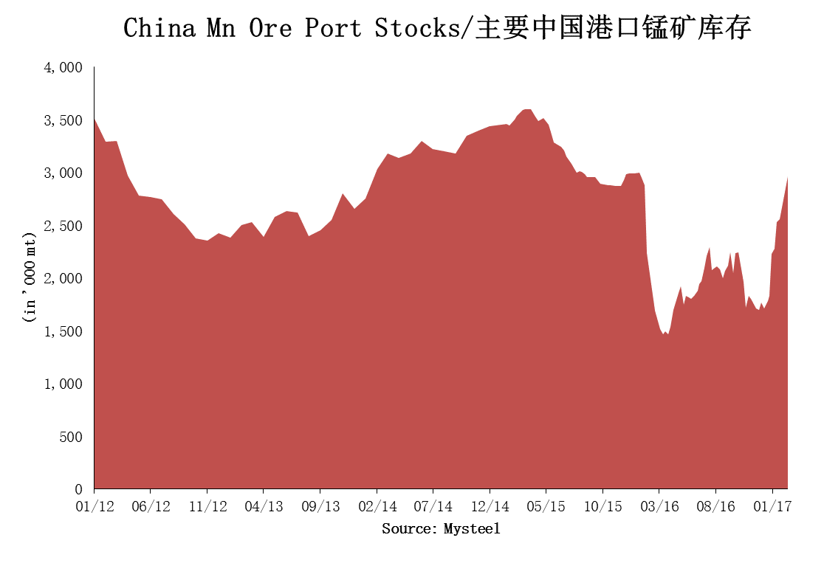
1 – Mn market review
D – Impact on China
Mn ore inventory at China ports experienced a big drop and jump.
Mn ore stock at China ports sharply increased since end of 2016, current stock is over 2.8 million tons.
As the largest Mn ore import port, Tianjin port is now holding over 2.2 million tons of Mn ore stock, around half of them are South African ore.

Slide 13
Outline
1 – Mn market review
A – Supply,
B – Demand,
C – Supply/Demand Balance
D – Impact on China market
2 – Mn market perspective

Slide 14
Sorry, IMnI is not allowed to do any forecast due to anti-trust reasons, but we can offer you below information for your own analysis and forecast:
Basic production, consumption and inventory data
Analysis and forecast tools
Latest industrial news and publications
All the figures and information of this presentation are from IMnI reports for members

Slide 15
The International Manganese Institute (IMnI) is a not-for-profit industry association that represents manganese ore and alloy producers, manufacturers of metallurgical products or chemical compounds, trading houses, industry service providers, companies involved in Mn business development, universities and research organizations around the world. Founded in 1975, with headquarters in Paris, France, IMnI's mission is to provide vision and guidance to the Mn industry by promoting economic, social and environmental responsibility and sustainability to all stakeholders.

Slide 16
IMnI
A – Market Research
Monthly Market Research Report
provide data and analysis of production, consumption, trade data, inventory changes and unit consumption for both manganese ore and manganese alloys
offer a better understanding of the current issues affecting the market.
Monthly Trade Data
provide information on the top 20 importers and deduced exporters of Mn products
provide members with a better understanding of international trade flows.
ROW Weekly Report and China Weekly Report
cover industry news, markets, regulatory activity and advances in science and technology relevant to Mn
keep our member’s up-to-date with the latest information to better help them run their businesses.
Other Reports
World Mn Projects
Annual Report
Special Studies and Papers

Slide 17
IMnI
B – HSE
The International Manganese Institute has a strong and enduring commitment to promoting good corporate citizenship amongst its members. Ensuring that member companies are informed of the best occupational safeguard measures to better protect their workers, that environmental protection measures are taken into account and that responsible attitudes are adopted vis-à-vis local communities, are paramount goals at the IMnI.。
the IMnI has completed its 1st the OHES 5-Year Plan (2011-2015). Costing some 4.3M Euros, the Plan designated the IMnI as the platform for providing the Mn industry with guidance, tools and information that would allow it to anticipate health, safety and environment demands whilst improving worker safety, sustainability and ensuring industry profitability. The plan developed around five main goals, namely to:
Anticipate & track major regulations worldwide
Develop economically sound industry safety standards
Study & limit occupational health effects
Quantify & evaluate environmental life cycle & risk
Knowledge-sharing and best practices through continuous improvement

Slide 18
IMnI
B – HSE
Projects related to health:
Scientific Criteria Document (completed)
Database of Worldwide Regulatory OELs (completed)
Measuring Exposure in the Workplace – IOM (completed)
Categorical Regression Analysis (ongoing)
PBPK Modeling of Inorganic Manganese (ongoing)
A review of Occupational Exposure Limits based on post 2004 publications (ongoing)
Ore Characterization for Classification & Labeling Purposes (ongoing)
Socio-Economic Analysis of the Mn industry (ongoing)
Projects related to environmental protection
Manganese Environmental Risk Assessment (completed)
Energy and Greenhouse Gas Emissions of Ferromanganese - Production - Matrix Summary (completed)
Water Quality Standard for Mn - Biotic Ligand Model (BLM) (completed)
Manganese Sustainability Programme (completed)
Manganese Life Cycle Assessment: Goal & Scope Review (completed)
Manganese Life Cycle Assessment: Final Full Report (completed)
LCA Poster (completed)
LCA Summary Report (completed)
LCA Brief (completed)
Life Cycle Assessment : A Cradle – to –Gate (ongoing)
Environmental Risk Assessment (ongoing)

Slide 19
IMnI
C – Regulatory Affairs
A group of member experts and consultants that scan and monitor global regulations as they develop, providing ensuring that IMnI is able to keep its members forewarned as well as forearmed with regulatory expertise.
The principal objectives of IMnI’s Regulatory Committee are threefold:
To identify and monitor those major regulations that can impact our industry.
To provide relevant information and support to Members so as to enable them to comply with regulations.
To establish a global network that can provide appropriate regulatory expertise to the IMnI, when necessary.
IMnI Members exclusively receive the following information from the Regulatory Affairs department:
A monthly newsflash of regional and country-specific regulatory developments emailed direct to members
Headline news published in the IMnI’s Manganese Matters
A quarterly Asia Regulatory Review including horizon scanning for changes and implications on the metals industry
Interpretation of new regulations and support for compliance when needed
A Helpdesk / Q&A on general regulatory issues
Access to a consultancy network for specific or regional assistance.

Slide 20
IMnI provide vision and guidance to the Mn industry by promoting economic, social and environmental responsibility and sustainability to all stakeholders. www.manganese.org

